Slide 1

Stage 2 Interview
Sports Biomechanics Data Scientist Task
Thomas Aston

Slide 2
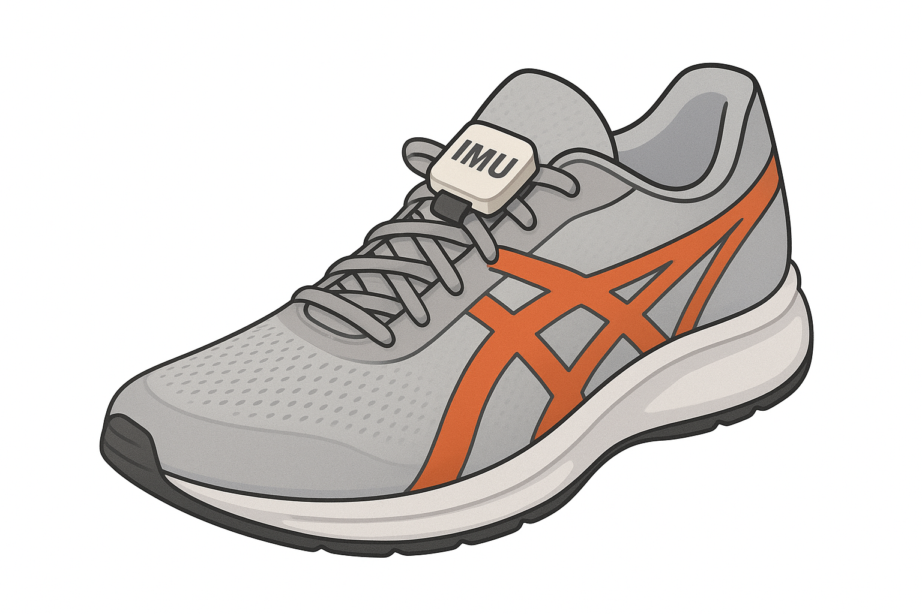
Data selection:
Requirements
Low cost
Stride
Sensitive
Portable/
Non-invasive

Slide 3
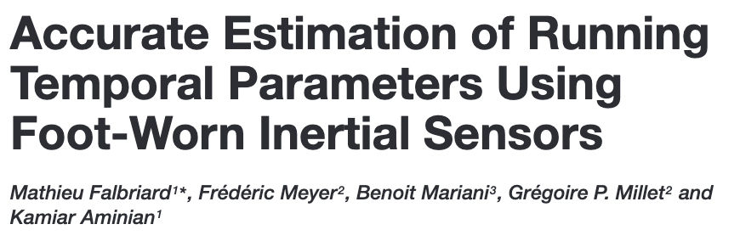
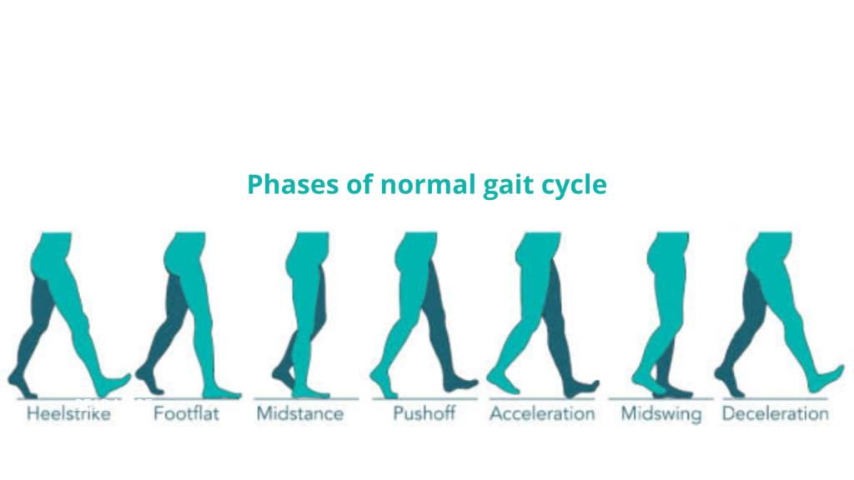
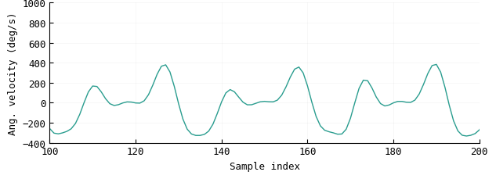

Data selection:
Events
Foot
contact
Foot
flat
Foot
off
Foot
contact
Foot
flat
Foot
off
Foot
contact
Foot
flat
Foot
off

Slide 4
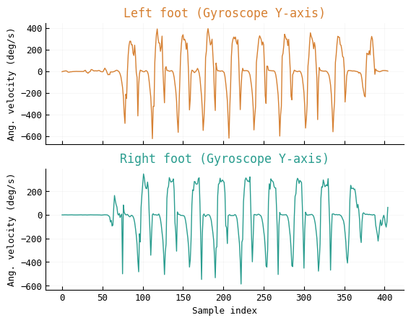
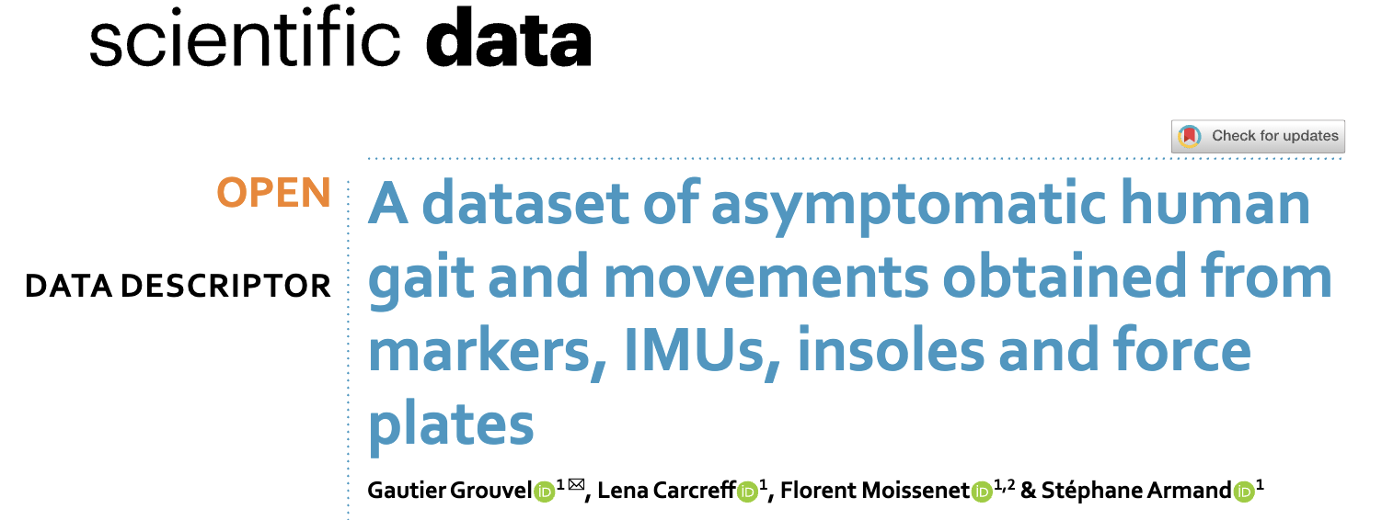
Data selection:
Open data

Slide 5
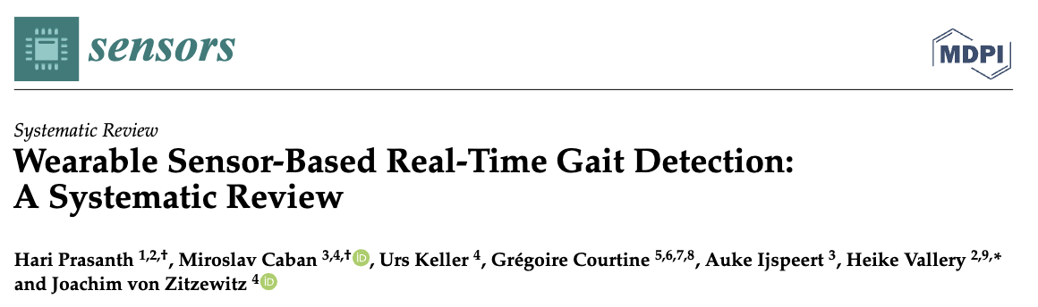
Event detection:
Requirements
Foot strike and foot off
Speed invariant
Real time

Slide 6
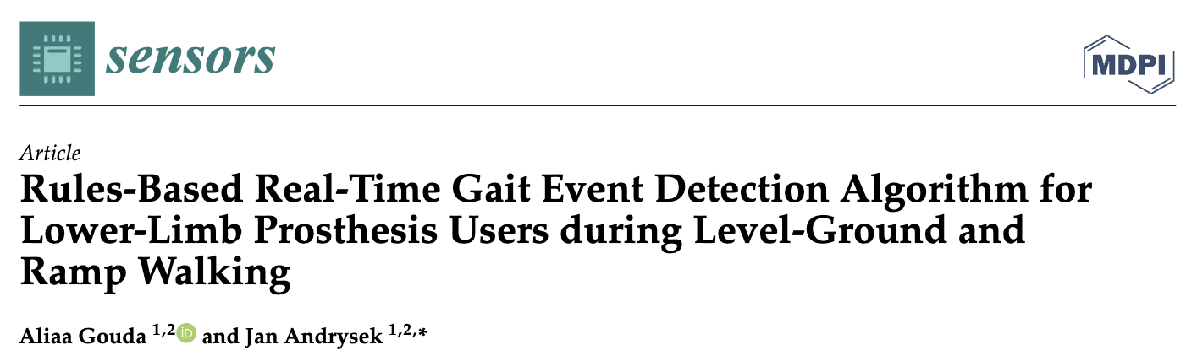
Event detection:
Implementation
Handles new samples as they ‘arrive’
FOR each new sample (left_gyro_y, right_gyro_y, timestamp):
FOR each foot ∈ [left, right]:
# 1. Real-time smoothing
smoothed = mean(last 15 gyro_y samples)
# 2. Detect MSW (zero-crossing + local min)
IF (prev_smoothed ≥ 0 AND smoothed < 0):
state = AFTER_ZERO_CROSSING
IF state = AFTER_ZERO_CROSSING:
IF is_local_min(smoothed_history) AND smoothed < msw_threshold:
EMIT MSW(timestamp)
# 3. Detect other events (prev_msw exists)
stride_time = Δt(MSW)
IF stride_time ∈ [0.1, 2.5] s:
seg = smoothed[prev_msw : curr_msw]
MS = argmin(seg[30–60%]); EMIT MS
FS = argmax(seg[start : MS]); EMIT FS
FO = argmax(seg[MS : end]); EMIT FO
prev_msw = curr_msw
state = SEARCHING
Analyses both feet
Causal filtering
State machine: check for zero-crossing
Detect local minima (mid swings)
Check for valid, complete stride (pair of mid swings)
Detect mid stance (min. velocity norm)
Detect foot strike and foot off (maxima)
Update state machine

Slide 7
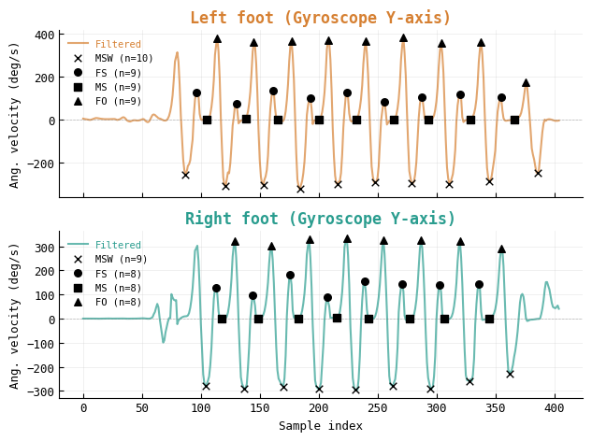
Event detection:
Performance

Slide 8
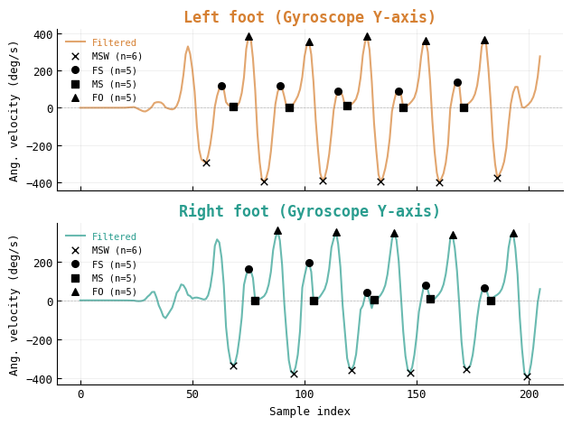
Event detection:
Performance

Slide 9
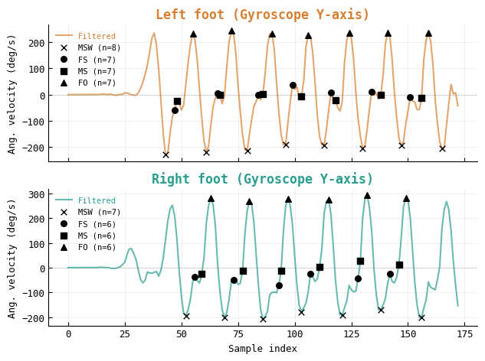
Event detection:
Performance

Slide 10
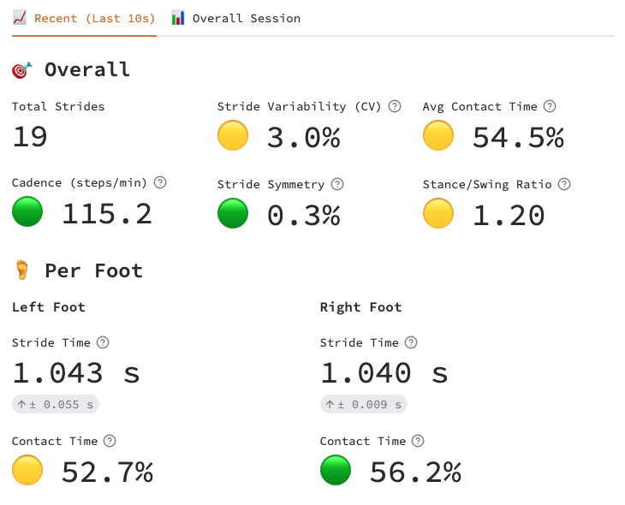
Metrics:

Slide 11
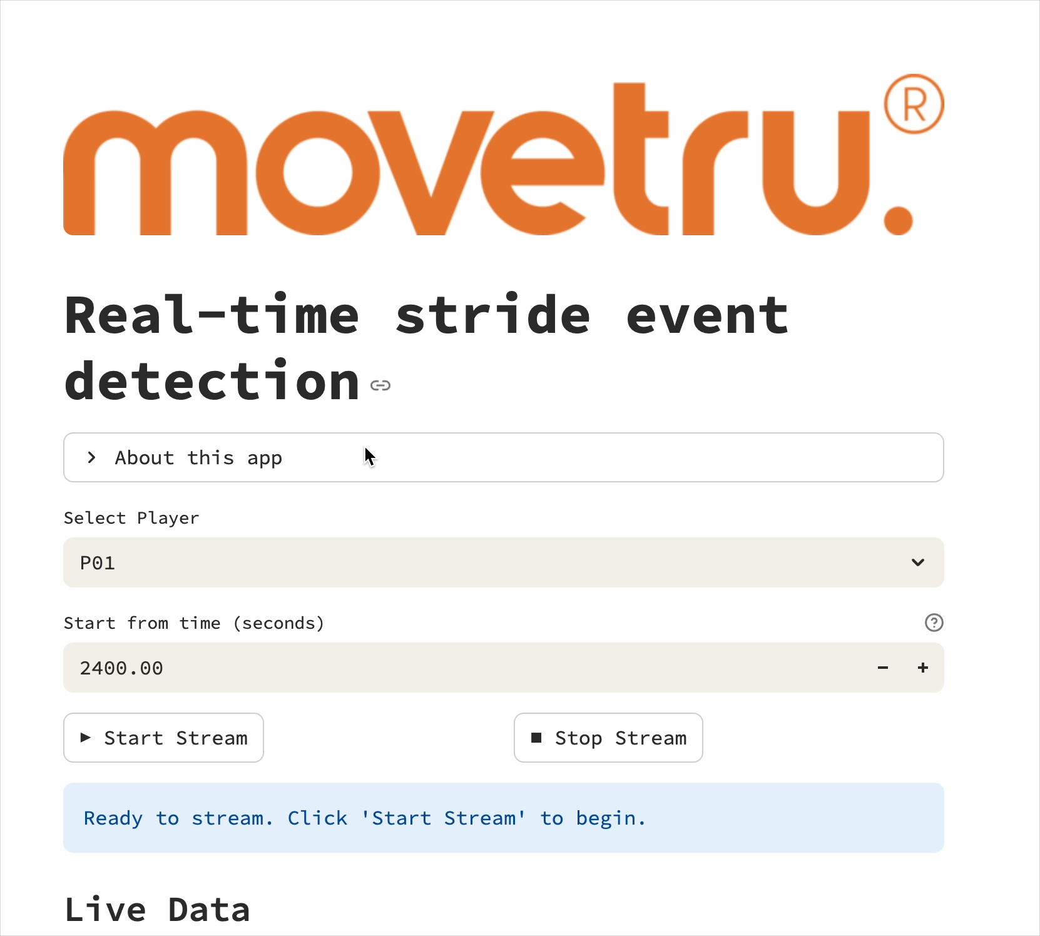
Demo:
movetru-stride.streamlit.app

Slide 12
Validation:
Lab
Goal:
Event timing accuracy + agreement of key metrics.
Reference:
Force plates (vertical GRF)
Pressure insoles (total force/ROI)
Mocap (kinematic proxy)
Protocol:
n≈20
varied speeds, conditions
1-2 min/condition
dual-foot IMUs
synced start
Scoring:
Detection: Precision/Recall/F1 score (match within threshold)
Timing: Bias and Limits of Agreement (Bland-Altman)
Derived metrics: stride, stance, swing etc.

Slide 13
Validation:
Field
Goal:
Real-world robustness & timing accuracy across terrains/speeds relevant to sport.
Reference:
Pressure insoles (total force / ROIs)
High-speed video 120–240 fps (spot checks)
(Optional) foot pod for cadence cross-check
Sync: clap/stomp; slate visible in video
Protocol:
Diff. surfaces and movements (relevant to sport)
Walk -> sprint; include fatigue
≥1000 strides total; dual-foot IMUs; natural footwear
Stress test: sensor alignment, sweat/rain, different shoes
Scoring:
Detection: Precision/Recall/F1 score (match within threshold)
Timing: Bias and Limits of Agreement (Bland-Altman)
Derived metrics: stride, stance, swing etc.

Slide 14
